Slide 1
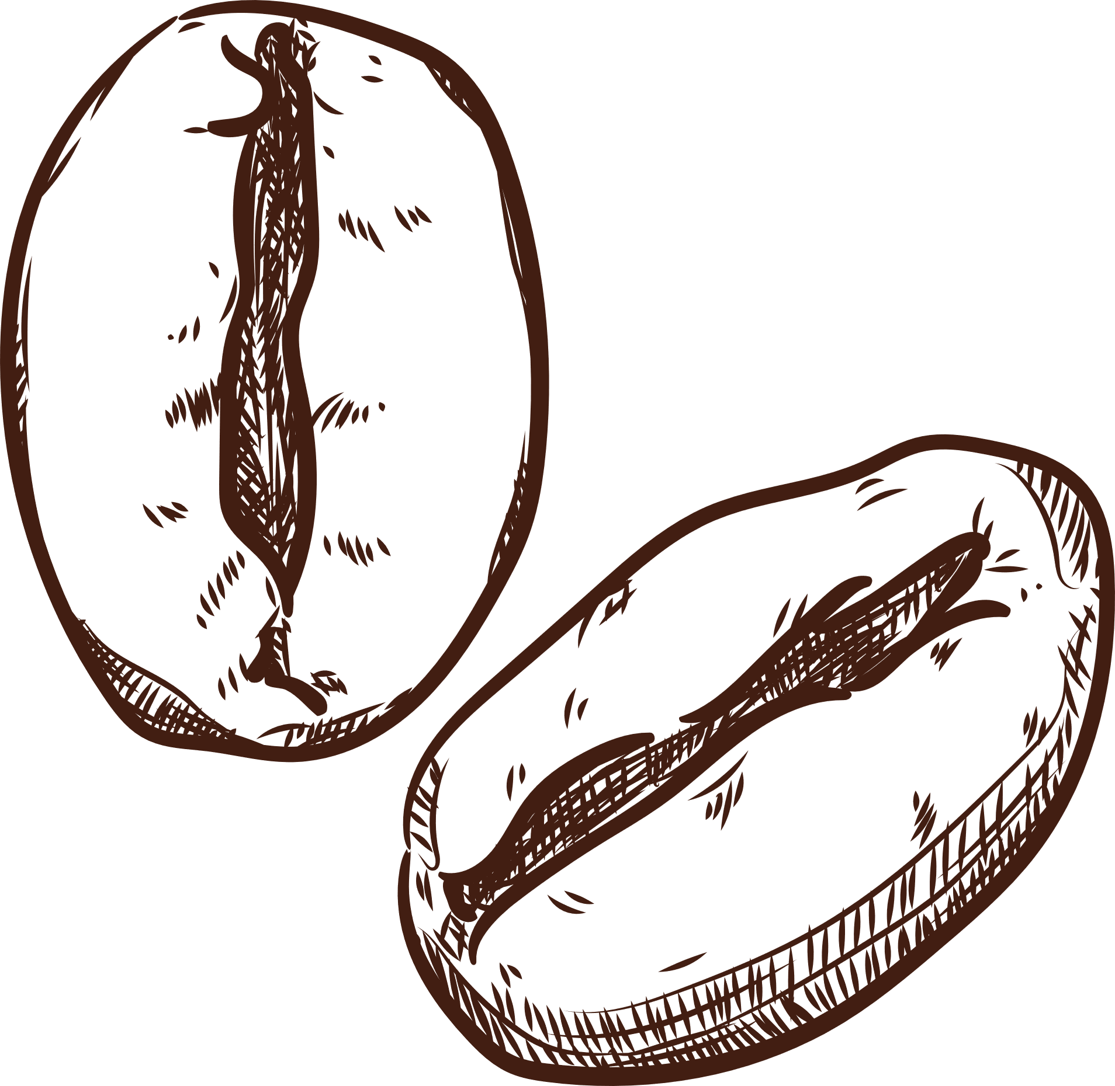

TEAM - HEARTS & BRAINS
PRESENTED BY:
ROHIT DESAI, LEO LIAO, MAANVEE MEHROTRA, HEMA SUDARSAN RAO

Slide 2
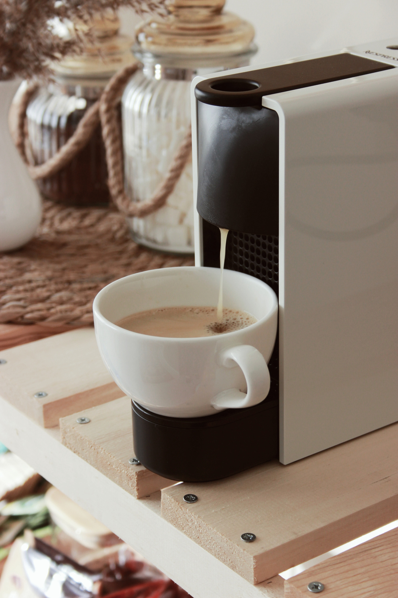
Table of Content
Our Question
Pilot and POT
Treatments
Methodology
Control variables
Analysis
Experimental Design
Conclusion

Slide 3
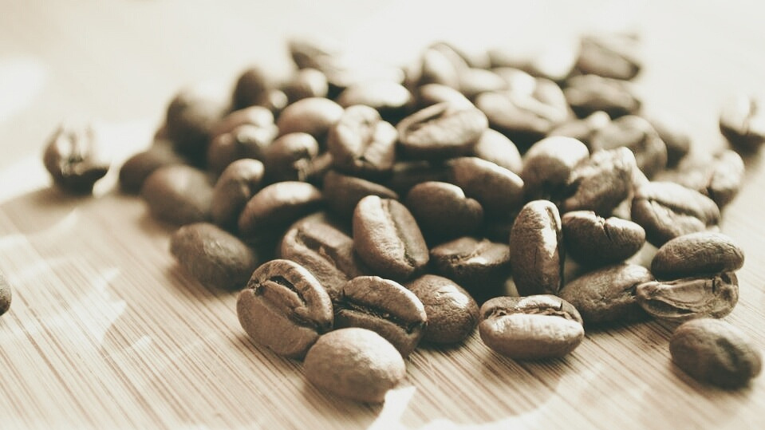

DO DIFFERENT TYPES OF CAFFEINATED DRINKS AFFECT THE HEART RATE?

Slide 4
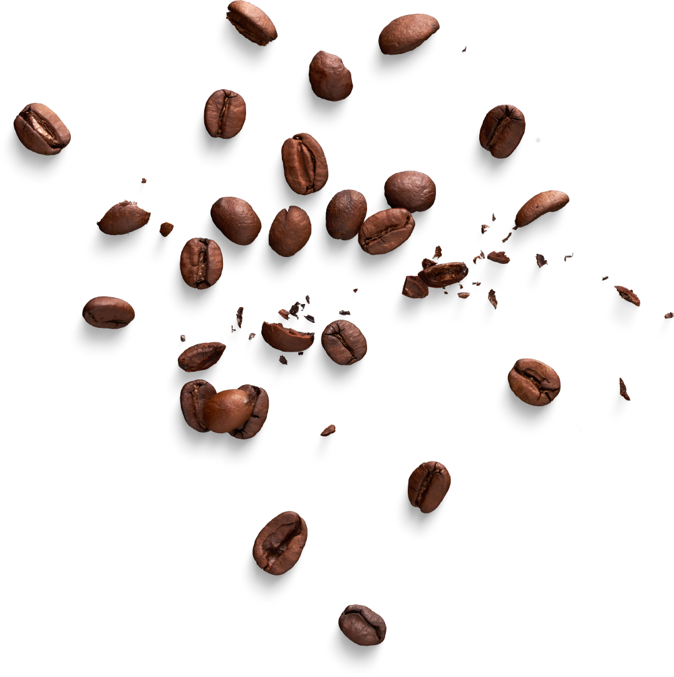


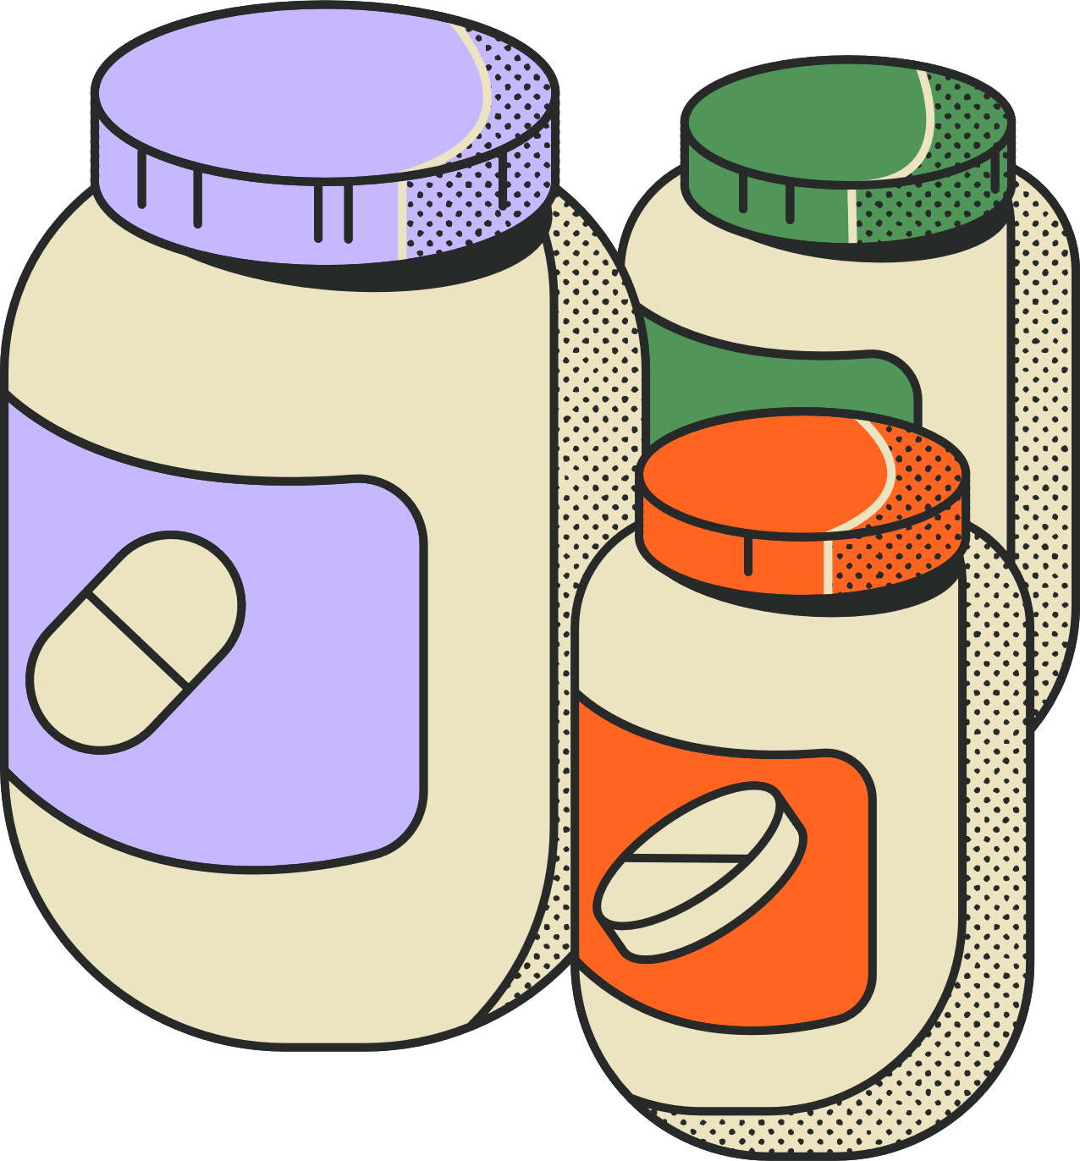
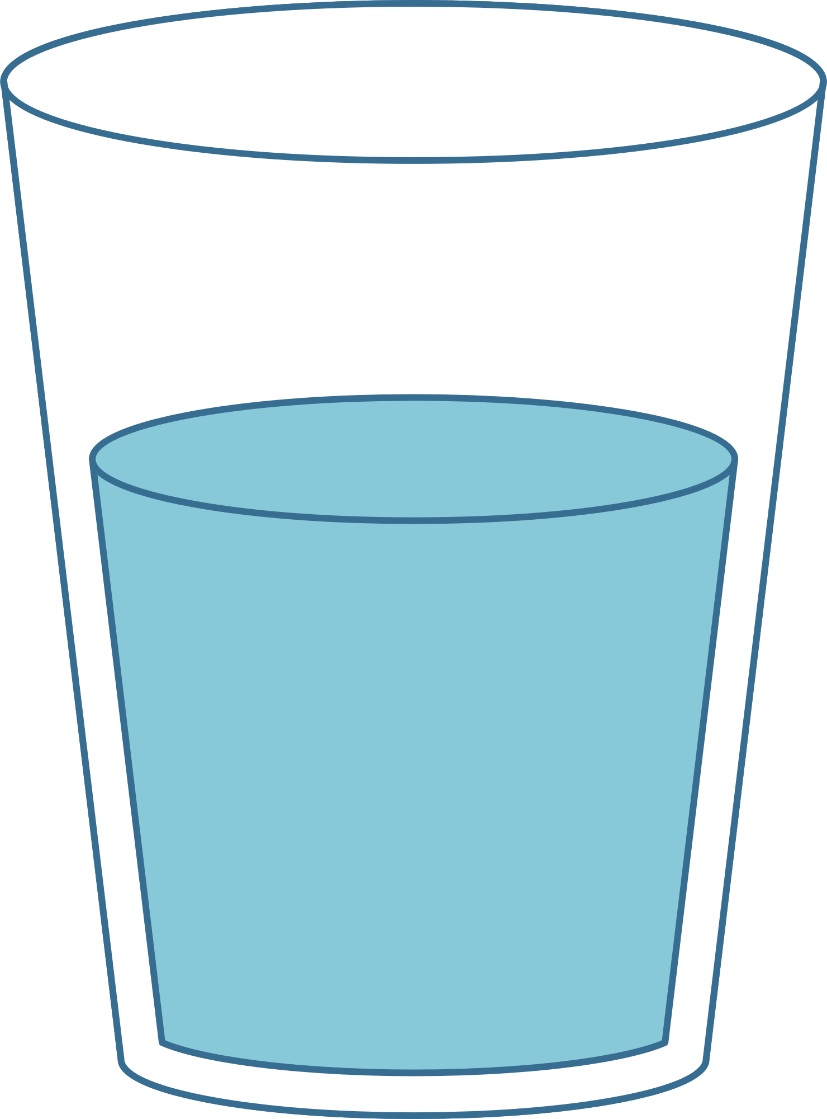
TREATMENTS
Coffee - 110mg
Energy Drink - 80mg
Pre-workout supplements - 225mg
Water - 0mg

Slide 5




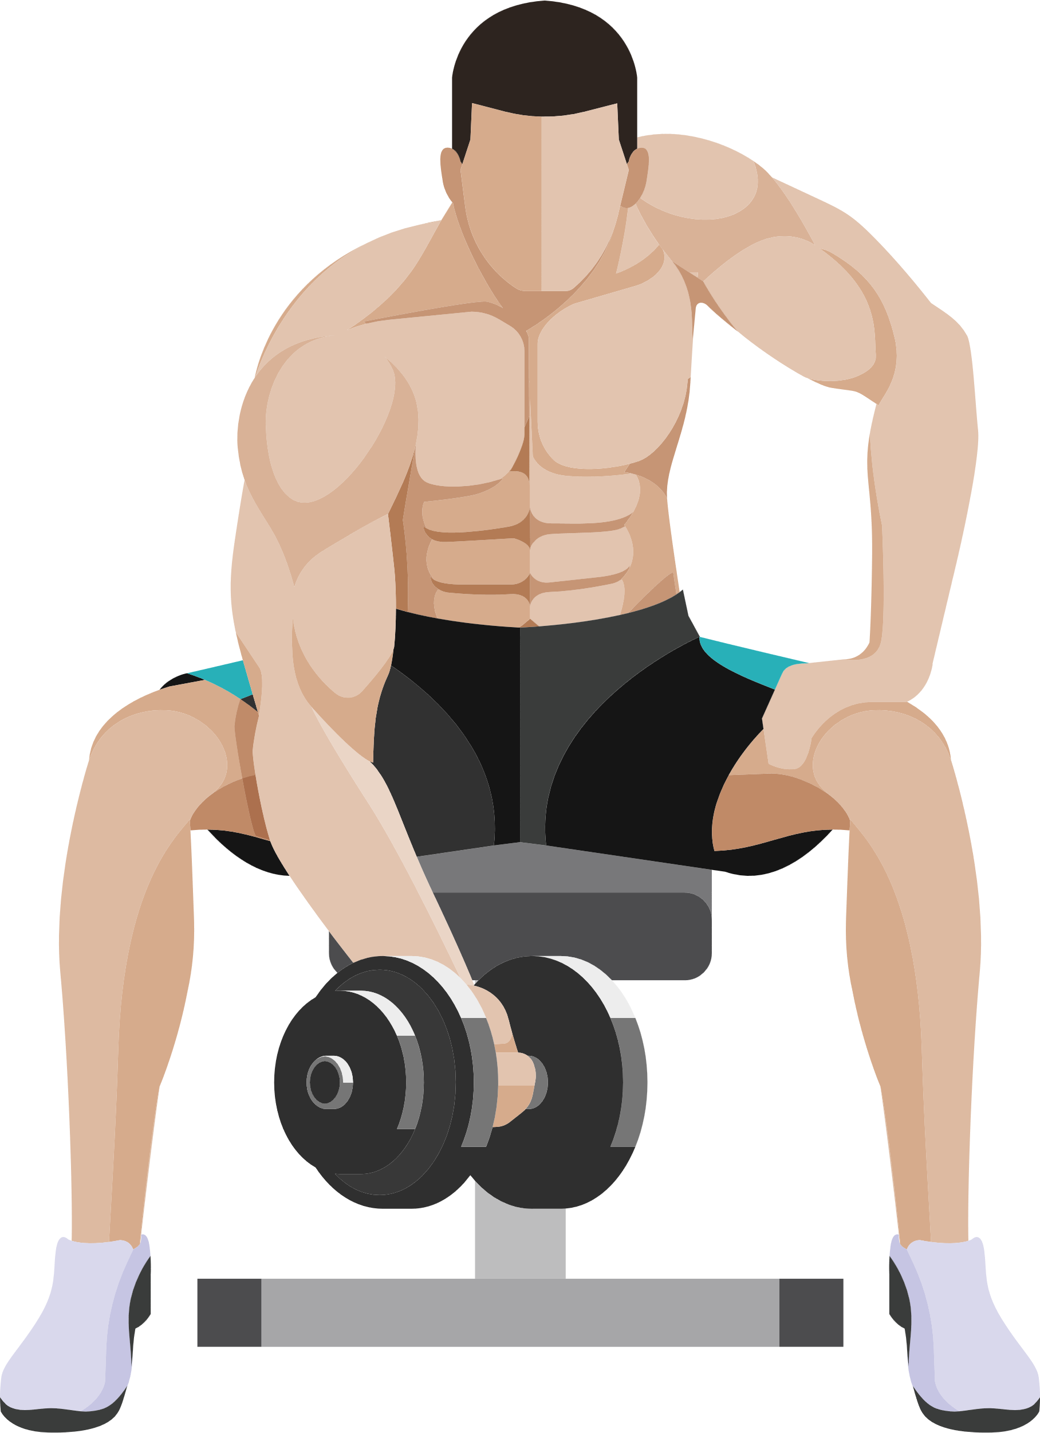
CONTROL VARIABLES
Age
Weight
Gender
Diet
Physical activity
Notes:
The purpose of control variables is to ensure that the only factor affecting HR is the caffeine level. Following can be the control variables for this experiment:

Slide 6




HOW ARE WE MEASURING?
Heart rate measurement before consumption
Heart rate measurement after 30mins of consumption

Slide 7



EXPERIMENTAL DESIGN
Target Population
(MSBA Cohort)
Randomization
(Simple Random Sampling)
Intervention
(Caffeine level)

Slide 8

PILOT & POWER OF THE TEST
0.05
ALPHA
0.9
POWER
32
SAMPLE SIZE

Slide 9

EXPERIMENT METHODOLOGY
Perform the final analysis to find the correlation and insights
Collect the data for other treatment groups as well
Perform the t-test to find if the data is statistically significant
Collect the data for coffee treatment group

Slide 10


ANALYSIS
Anderson Darling test
(Normality)
Bartlett’s test
(Const. Var)
Tukey’s test
(Difference in groups)
Welch’s
ANOVA
ATE
t-test
Notes:
Coffee has similar effects on both genders.
Energy Drink (Red Bull) heightens male heart rate more than females.
Pre-Workout has very significant effect on the heart rates in both gender, effecting women more.

Slide 11
INTERPRETATIONS OF THE TUKEY’S RESULTS
Energy Drinks vs. Coffee: p-adj = 0.926 (not significant)
Pre-Workout vs. Coffee: p-adj = 0.0000055 (highly significant)
Water vs. Coffee: p-adj < 2e-16 (highly significant)
Pre-workout vs. Energy Drinks: p-adj = 0.0000003 (highly significant)
Water vs. Energy Drinks: p-adj < 2e-16 (highly significant)
Water vs. Pre-workout: p-adj < 2e-16 (highly significant)
In summary, there are significant differences in the "Difference" variable among the groups, and the specific differences are highlighted by the post-hoc tests. It appears that Pre-workout and Water exhibit significant differences compared to Coffee and Energy Drinks.
Notes:
Coffee has similar effects on both genders.
Energy Drink (Red Bull) heightens male heart rate more than females.
Pre-Workout has very significant effect on the heart rates in both gender, effecting women more.

Slide 12
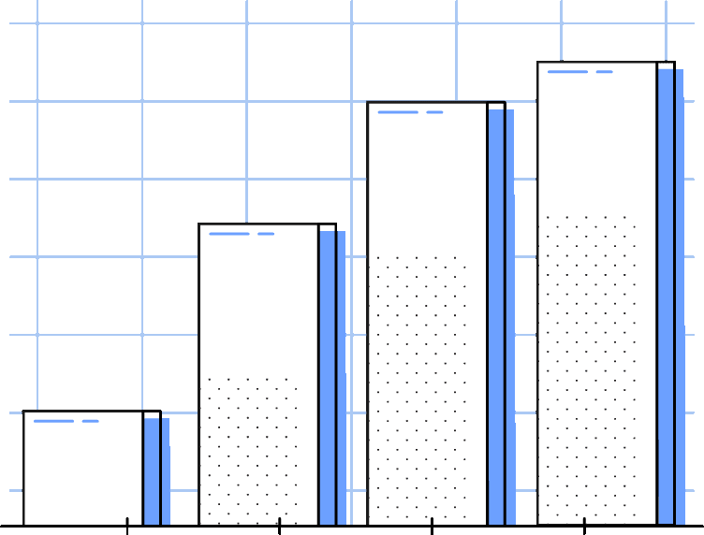
HOW DO THE RESULTS VARY BASED ON THE CONTROL VARIABLES?
Notes:
Coffee has similar effects on both genders.
Energy Drink (Red Bull) heightens male heart rate more than females.
Pre-Workout has very significant effect on the heart rates in both gender, effecting women more.

Slide 13
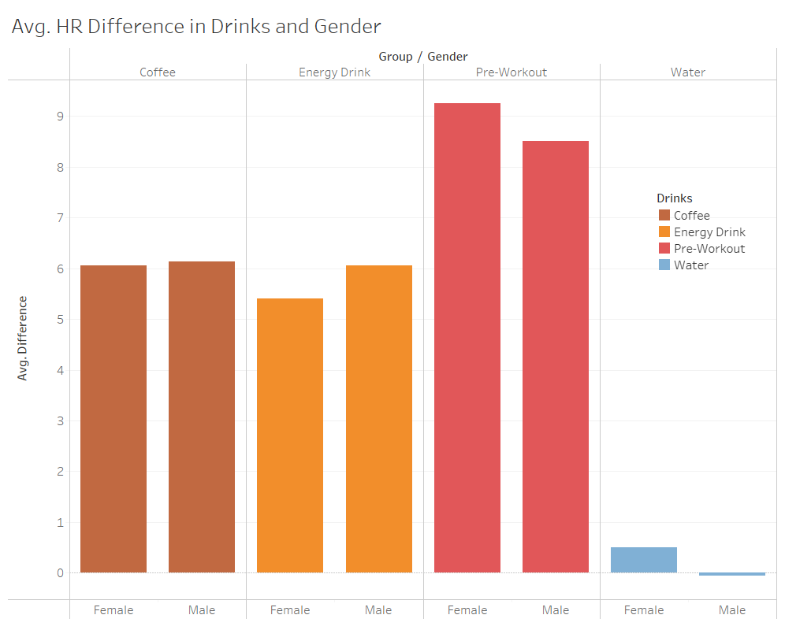
AFFECTS OF GENDER ON HEART RATE
We can see that there isn’t a significant difference in the measurements for males and females. The only difference is in pre-workout supplements, where we see one bpm difference on average between them.
Notes:
Coffee has similar effects on both genders.
Energy Drink (Red Bull) heightens male heart rate more than females.
Pre-Workout has very significant effect on the heart rates in both gender, effecting women more.

Slide 14
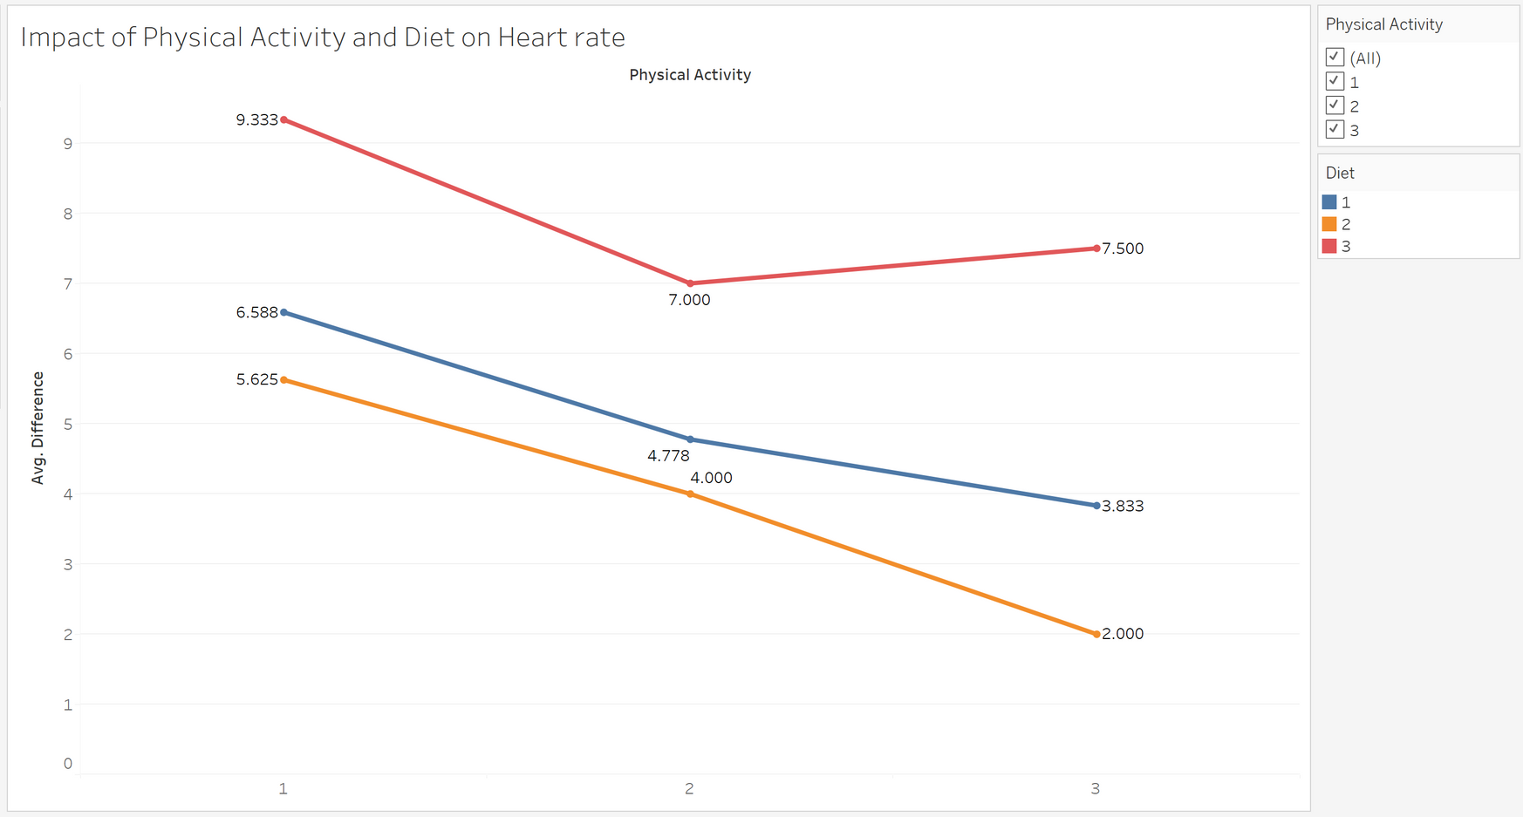
DO DIET AND PHYSICAL ACTIVITY AFFECT THE HEART RATE?

Slide 15

CONCLUSION
1. Dosage and Heart Rate:
Higher caffeine doses directly raise the heart rate. Pre-workout supplements have the highest impact on heart rate.
2. Caffeine Source Variation:
Different caffeine sources affect heart rate differently.
3. Dietary Influence:
Unhealthy diets may heighten susceptibility to heart rate fluctuations after caffeine intake.

Slide 16

QUESTION TIME

